Slide 1
Graph representation

Slide 2
What is graph? Representation
Need to represent graph in computer.
3 usual types of representation։
List of Edges
Connection List
Connection Matrix

Slide 3
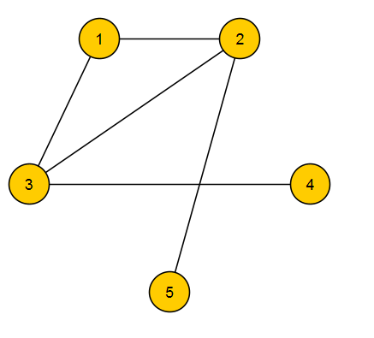

What is graph? Representation։ List of Edges
Simple enumeration of edges:
For this example list of nodes is {1, 2}, {2, 1} {1, 3}, {3, 1} {2, 3}, {3, 2} {2, 5}, {5, 2} {3, 4}, {4, 3}
Can be used 2 arrays from and to.
Can be used array of pairs.

Slide 4
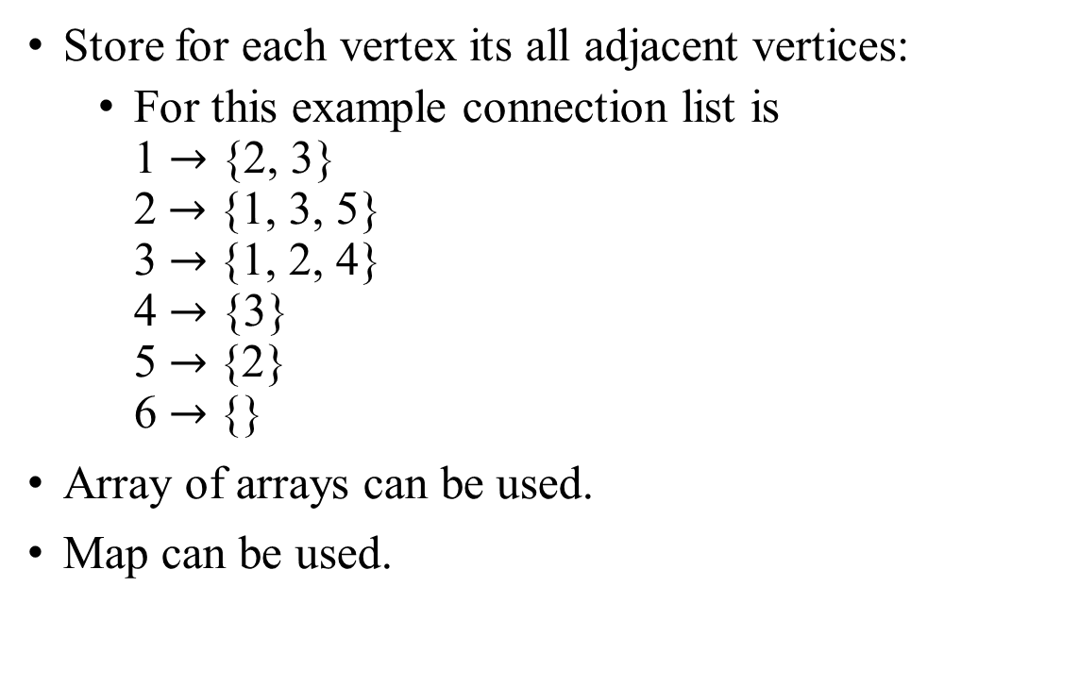
What is graph? Representation։ Connection list
Store for each vertex its all adjacent vertices:
For this example connection list is 1 $→$ {2, 3} 2$→$ {1, 3, 5} 3 $→${1, 2, 4} 4 $→$ {3} 5 $→${2} 6 $→${}
Array of arrays can be used.
Map can be used.

Slide 5
What is graph? Representation։ Connection matrix
If there is an edge between vertices i and j then (i, j)-th of matrix is set to true, and false in other case:
For this example connection matrix is
Array of arrays can be used.
 | 1 | 2 | 3 | 4 | 5 | 6
1 | 0 | 1 | 1 | 0 | 0 | 0
2 | 1 | 0 | 1 | 0 | 1 | 0
3 | 1 | 1 | 0 | 1 | 0 | 0
4 | 0 | 0 | 1 | 0 | 0 | 0
5 | 0 | 1 | 0 | 0 | 0 | 0
6 | 0 | 0 | 0 | 0 | 0 | 0

Slide 6
What is graph? Representation։ Directed graph
In case of directed graph representation remains same, but edges are added only in one direction.
For example connection matrix for directed graph will be:
Note that for undirected graph (i, j) is always equal to (j, i). In case of directed there is no such rule.
 | 1 | 2 | 3 | 4 | 5 | 6
1 | 0 | 1 | 0 | 0 | 0 | 0
2 | 0 | 0 | 0 | 0 | 1 | 0
3 | 1 | 1 | 0 | 1 | 0 | 0
4 | 0 | 0 | 0 | 0 | 0 | 0
5 | 0 | 0 | 0 | 0 | 0 | 0
6 | 0 | 0 | 0 | 0 | 0 | 0

